Slide 1
CMU 10-742 Machine Learning in Healthcare
Lecture 8: Paying for Health Care
Pamela Peele
Notes:
Last week or “escape velocity”

Slide 2
Course Logistics
Assignment 2 due next Thur (Sep 26)
Final Project Milestone 1 is Oct 10
My Sep 24 office hours cancelled
Notes:
No readings for next week, but there is homework!
Medicare shopping exercise due by Tuesday’s lecture
Look at Canvas

Slide 3
About Medicare
Medicare is a federal health insurance program for people who are:
Age 65 or older, OR
Under the age of 65 with certain disabilities, OR
In end-stage renal disease
Types of Medicare Coverage
Part A: Hospital coverage
Part B: Outpatient coverage
Part C: Medicare Advantage
Part D: Prescription Drug Coverage
Medicare Supplemental Plans (Medigap)
Special Needs Plans

Slide 4
Traditional Medicare – Parts A & B
Part
(Think doctor’s office)
Doctor visits and preventive care
Testing and labs
Durable medical equipment (DME)
Ambulance services
Some outpatient services
A
B
Not Covered
Dental care
Vision
Hearing care, hearing aids
Long-term custodial services, e.g., nursing homes
Part
(Think hospital)
Inpatient hospital care
Skilled nursing care
Hospice care
Home health care

Slide 5
Original Medicare – Parts A & B
Part B Premiums
If yearly income in 2023 was: |  |  | Beneficiary Pays
File individual tax return | File joint tax return
$103,000 or less | $206,000 or less |  | $174.70
above $103,000 up to $129,000 | above $206,000 up to $258,000 |  | $244.60
above $129,000 up to $161,000 | above $258,000 up to $322,000 |  | $349.40
above $161,000 up to $193,000 | above $322,000 up to $386,000 |  | $454.20
above $193,000 and less than $500,000 | above $386,000 and less than $750,000 |  | $559.00
$500,000 or above | $750,000 or above |  | $594.00

Slide 6
Original Medicare – Parts A & B
Part A Deductibles & Coinsurance per Benefit Period
Hospital Stay | Beneficiary Pays
Deductible for each benefit period | $1,632
Coinsurance for Day 1 – 60 | $0 (Medicare pays in full after deductible)
Coinsurance for Day 61-90 | $408 per day
Coinsurance for Day 91+ | Beneficiary pays in full
Coinsurance for Lifetime Reserve Days | $816 per day
Benefit Period
Varies by beneficiary and is not a fixed unit
Begins with the first inpatient admission
Ends after 60 consecutive days without an admission
No limit to the amount of benefit periods in a calendar year
Skilled Nursing Facility Stay | Beneficiary Pays
Coinsurance for Day 1 – 20 | $0 (Medicare pays in full after deductible)
Coinsurance for Day 21-100 | $204 per day
Coinsurance for Day 101+ | Beneficiary pays in full
Lifetime Reserve Days
Additional days that Medicare will cover once a hospital stay exceeds 90 days in a benefit period
60 days are allocated during lifetime
Important Factor: There is no Maximum Out-of-Pocket spend

Slide 7
Medicare Prescription Drug Benefit (Part D)
Factors that influence Drug Costs (varies by plan)
Pharmacy type
Preferred
Standard
Mail-order: discounted 90-day copays
Drug Tiers
1: Preferred generic
2: Generic $
3: Preferred Brand $$
4: Non-Preferred Drug $$$
5: Specialty $$$$

Slide 8
Medicare Advantage (Part C)
C
Part
Medicare Advantage Plans Original Medicare benefits, plus extras
Covers everything in Parts A and B
Can have benefits like hearing, dental, and vision
Most include drug coverage (Part D)
Plans may charge a monthly premium and/or include copayments, coinsurances and/or deductibles
Plans have a Maximum Out-of-Pocket
Must have Medicare Part A and B to enroll in Part C (Medicare Advantage)
Initial Enrollment Period Three months before, the month of, and three months after the month you’re Medicare eligible. This could be the month you turn 65, or it could be the month you’re no longer covered by your employer if you choose to work past 65.
Annual Enrollment Period
October 15 – December 7
Open Enrollment Period
January 1 – March 31
Special Enrollment Periods Can happen any time throughout the year due to certain life events.

Slide 9
Medicare Advantage (Part C)
Types of Medicare Advantage Plans
Individual Plans | Medicare beneficiaries purchase plans for their own coverage during Medicare Annual Enrollment Period (Oct. 15th – Dec. 7th)
Special Needs Plans | D-SNP: eligible for both Medicare & Medicaid C-SNP: beneficiaries with severe chronic or disabling conditions I-SNP: beneficiaries requiring nursing home or institutional care
Employer or Union Sponsored Plans | Beneficiaries can choose to enroll in plans if employer or union works with an insurance plan to cover Medicare benefits for its retirees

Slide 10
Medicare Advantage (Part C)
Major differences between Medicare Advantage and Original Medicare
 | Medicare Advantage | Original Medicare
Additional Benefits | Covers all services and items under Part A and Part B Many cover additional benefits (e.g., dental, vision, hearing, gym memberships, etc.) | Benefits are limited only to services and items covered under Part A and Part B
Provider Networks | Access is limited to providers within the plan’s network Out-of-Network benefits are provided for some plans | Beneficiaries can see any doctor or hospital who accepts Medicare
Managed Care | Some services may require a prior authorization, requiring evidence to show medical necessity | Not applicable

Slide 11
Medicare Supplemental Plans (Medigap)
About Medigap
Secondary insurance to Original Medicare (Parts A and B)
Additional monthly premiums
Coverage at any provider nationwide who accepts Original Medicare (i.e., no provider network)
Additional benefits, such as vision, dental, hearing, etc. are NOT covered
Must purchase a separate Part D plan for prescription drug coverage
Medigap Considerations
Must have Parts A and B to enroll in Medigap
Eligibility begins the month after the 65th birthday
Cannot be enrolled in both Medigap and Medicare Advantage
Plans are standardized and identified by letters A – N
Must add Part D drug coverage to avoid penalty

Slide 12
Medicare Supplemental Plans (Medigap)
 | Plan A | Plan B | Plan C | Plan D | Plan F | Plan G | Plan K | Plan L | Plan M | Plan N
Part A coinsurance and hospital costs up to an additional 365 days after Medicare benefits are used up |  |  |  |  |  |  |  |  |  | 
Part B coinsurance or copayment |  |  |  |  |  |  | 50% | 75% |  | 
Blood (first 3 pints) |  |  |  |  |  |  | 50% | 75% |  | 
Part A hospice care coinsurance or copayment |  |  |  |  |  |  | 50% | 75% |  | 
Skilled nursing facility care coinsurance |  |  |  |  |  |  | 50% | 75% |  | 
Part A deductible |  |  |  |  |  |  | 50% | 75% | 50% | 
Part B deductible |  |  |  |  |  |  |  |  |  | 
Part B excess charge |  |  |  |  |  |  |  |  |  | 
Foreign travel exchange (up to plan limits) |  |  | 80% | 80% | 80% | 80% |  |  | 80% | 80%
Out-of-pocket limit | N/A | N/A | N/A | N/A | N/A | N/A | $7,060 | $3,530 | N/A | N/A

Slide 13
Shopping for a Medicare Advantage Plan

Slide 14
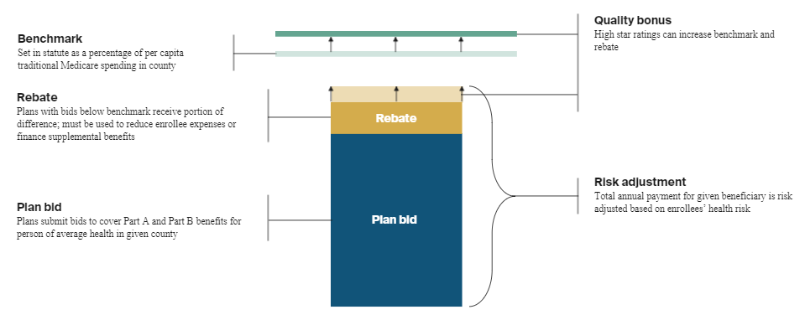
Medicare Quality – Star Ratings
Quality Bonus Payments (QBPs) and Rebate adjustments are determined by annual Star Rating
About Stars
Annual rating 5 Stars (excellent) to 1 Star (poor)
Assessed on industry curve through claims, clinical data, member survey and various administrative data sources
What is Measured
Clinical Performance (HEDIS)
Drug Performance (PQA)
Member Experience (CAHPS)
Health Outcomes (HOS)
Appeals Processing
Complaints
Disenrollment
Drug Pricing Accuracy
Foreign Lang. / TTY Availability
Business Implications
3.5 Stars: Increased Rebate
4 Stars: Quality Bonus Payment
4.5 Stars: Increased Rebate
5 Stars: Year-long enrollment

Slide 15
Risk Adjustment
Total capitated payment to plan is adjusted based on the beneficiaries’ risk scores
About Risk Adjustment
CMS assigns a risk score to each Medicare Advantage beneficiary based upon demographic and disease factors
Retrospective claims allowed
Higher risk scores = higher payments to plans
Business Implications
Annual risk coding collection
Retrospective government audits
Can support additional benefits to members
Can change provider behavior

Slide 16
Medicaid Eligibility Criteria
Medicaid eligibility is based on both financial and non-financial criteria
Eligibility factors include:
Family income
Family size
Age
Other factors such as being pregnant or having a disability
An Individual must also be:
A U.S. citizen or certain qualified non-citizen
A resident of the state in which they are applying

Slide 17
2022 Federal Poverty Level (FPL)
Persons in Household | Poverty Guideline (100% FPL)
1 | $13,590
2 | $18,310
3 | $23,030
4 | $27,750
5 | $32,470
6 | $37,190

Slide 18
State Examples: Medicaid Eligibility Levels/FPL
State | Children 0-18 | Pregnant Women | Parent/ Caretaker Adults | Expansion Adults
Alabama | 141% | 141% | 13% | NA
California | 261% | 208% | 109% | 133%
Colorado | 142% | 195% | 68% | 133%
Michigan | 212% | 195% | 54% | 133%

Slide 19
Medicaid Mandatory Medicaid Services
Inpatient and outpatient hospital services
Physician services
Federally Qualified Health Center (FQHC) & Rural Health Clinic (RHC) services
Nursing facility services for individuals 21 years of age and older
Home Health Services
Laboratory and x-ray services
Family planning services and supplies
Certified Pediatric and Family Nurse practitioner services
Nurse mid-wife services
Free-standing Birth Center Services
Tobacco cessation counseling for pregnant women
Early, Periodic, Screening, Diagnostic, Treatment (EPSDT) Services for children under 21 years of age
Transportation to medical care

Slide 20
Dual Eligibles
Across the United States, 12.5 million people are jointly enrolled in Medicare and Medicaid. These individuals are referred to as dually-eligible beneficiaries or dual eligibles.
Medicare covers their primary health insurance with some support from state Medicaid programs.
People enrolled in both Medicare and Medicaid comprise 17% of Medicare beneficiaries in traditional Medicare and 14% of Medicaid enrollees, but much higher shares of spending (33% of traditional Medicare spending and 32% of Medicaid spending).

Slide 21
Commercial Health insurance
64.3% of those under the age of 65 have private health insurance in 2020.
Employer
On Exchange
Off Exchange
58.6% of adults 65 or younger use employer-based health insurance.
Cover approximately 70% of cost of premiums
4.0 % of adults 65 or younger used the Exchange.
Federal or State Individual Marketplace websites
Financial assistance available based on meeting requirements
6.7% of adults 65 or younger obtained their health insurance off exchange.
Directly from insurance company or broker.
No financial subsidies for financial assistance.

Slide 22
HMO-Health Maintenance Organization It’s impact on encounter data
PCP Gatekeeper model
Increases PCP encounters
Decreases specialists encounters
Strict provider network with no out of network providers (except emergent care) which concentrates procedures among a smaller set of providers and produces more volume per provider
Notes:
LA department of Water and Power
Prepaid medical plan for workers.
Dr. Donald Ross and Dr. H. Clifford Loos established this program.
Covered physician and hospital based charges.
Focused on prevention and health maintenance.
Ross and Loos were expelled from their local medical society for it.
1950’s to compete with HMO’s who main structure at the time was a closed system of mostly owned physician practices
Shifted to independent practice association (IPA) model where the HMO contracts with multiple physician practices and or with organizations that acted as the middle person who in turn organized contracting with “networks” they have establish of physician practices.
This was created by the San Joaquin County Medical Society in CA to compete with Kaiser.
This also was the first time a relative fee schedule was established along with quality monitoring and establishment of a process for complaints and grievances.
1973 HMO Act that we discussed earlier. This was a major turning point for HMO’s. With the dual choice mandate this was an open door for HMO’s. This expired in 1995.
Federal grants and loans for building and expanding HMO’s
Federal legislation superseded state laws that restricted HMO’s
Dual Choice provision for employers with 25 employees or more who offered indemnity coverage also had to offer a federally qualified HMO

Slide 23
PPO-Preferred Provider Organization
No primary care referral needed for specialty care or diagnostics
Generally, a larger network of facilities and providers
May have tiered networks – provider concentration
Reduces provider concentration – fewer observations per provider

Slide 24
High Deductible Health Plans
Must have a health savings account (HSA)
IRS Requirements for 2024
Annual Deductible
$1,600 or greater – Individual
$3,200 or greater – Family
Annual Out of Pocket Maximum
$ 8,050 – Individual
$16,000 – Family
Annual Contribution Limit
$4,150 – Individual
$8,300 – Family
Creates a disincentive for initial visits, especially for clinic visits, that is seasonal
No financial barrier after MOOP, increases encounters and resets annually. Seasonal effect

Slide 25
Exclusive Provider Organization and Point of Services Plans
EPO
POS
Similar to PPO but more restrictive network.
No designated primary care physician required or primary care physician referrals.
Usually little to no out-of-network coverage.
Larger but not open provider networks
No designated primary care physician required or primary care physician referrals.
Out-of-network coverage though usually pay a percentage of cost.
Concentrates specialist encounters

Slide 26
The Hard Problems
Risk Adjustment
Financial : PMPM
Clinical: co-morbidity and severity
Prospective vs Retrospective
Influence on future data and resulting models

Slide 27
Financial risk adjustment
Unit of observation
MONEY
Contributing factors
Benefit design
Site of service
Adherence to treatment plans

Slide 28
Provider Performance and Reimbursement
Controlling for clinical risk
Data source...commonly billable encounters
What risk?
The circular problem.

Slide 29
The Challenge
How to use ML to improve clinical risk adjustment
For payers (think bundling payments)
For providers (complexity based reimbursements)
For patient – provider matching models

Slide 30
Clinical Risk Adjustment: without using $$$$
Unit of observation
Comorbidity
Clinical complexity
Contributing factors
Diagnosis
Type of service use
Circular problem – again
Seasonality problem

Slide 31
Creating Neighborhoods
Use of clinical vectors
Creating clusters of similar clinical vectors

Slide 32
Thinking with Data
Pamela Peele, Ph.D.
Chief Analytics Officer
UPMC Health Plan & UPMC Enterprises
March 2021

Slide 33

Consuming Something Different

Slide 34

Where does Data fit into the future of health care?
A measure of Clairvoyance
New knowledge not previously possible
Learning what isn’t known.
Hypothesis free approaches to problems.

Slide 35



The “Transaction” Problem in Healthcare

Slide 36
Discharge Advocate: Risk Models Identify Readmission “Sweet Spot”
Lower Risk of Readmission
SWEET SPOT
Less Actionable

Slide 37
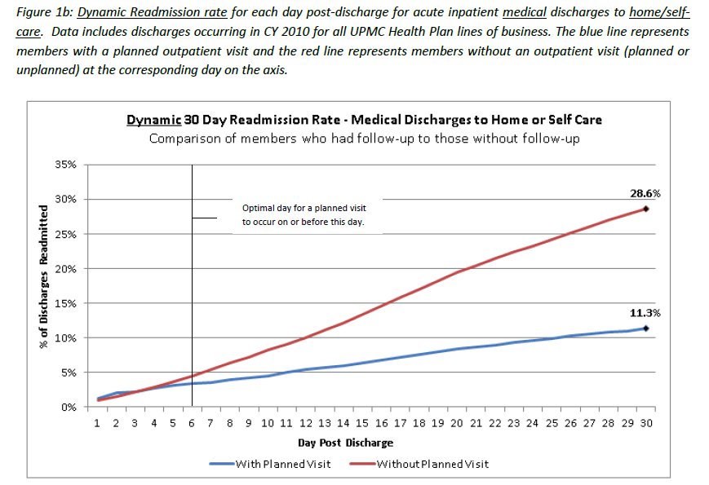

Slide 38
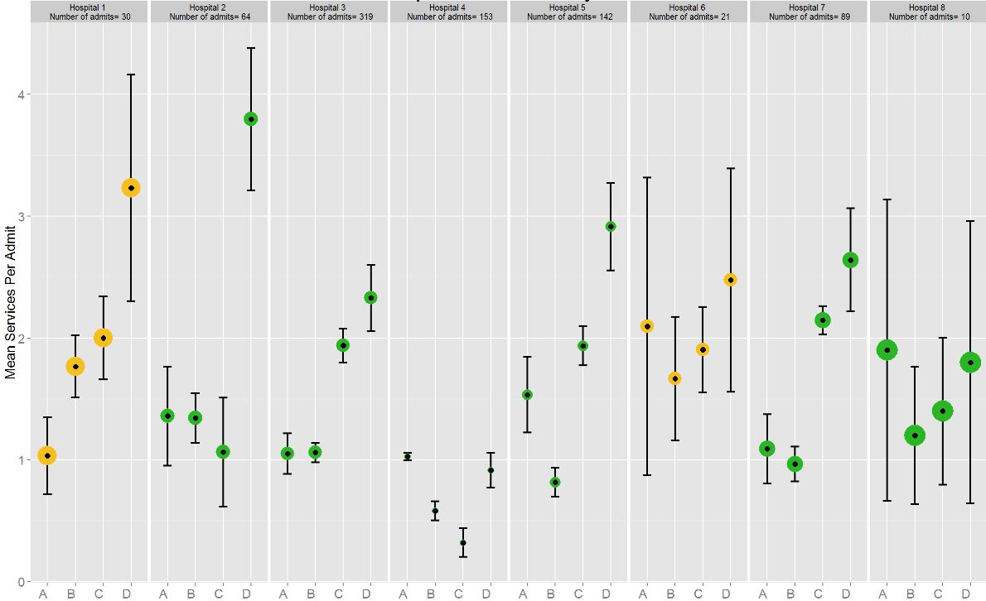
Average Services Per Admit
DRG 470 – Major Joint Replacement
Bubble Size is Proportional to 30 Day Readmission Rate
Median Diagnoses During IP Stay
< 8
> 8
A = Imaging
B = Consultation
C = Testing
D = Attending

Slide 39
Provider Network Plot

Slide 40
Provider Patient Sharing Patterns

Slide 41
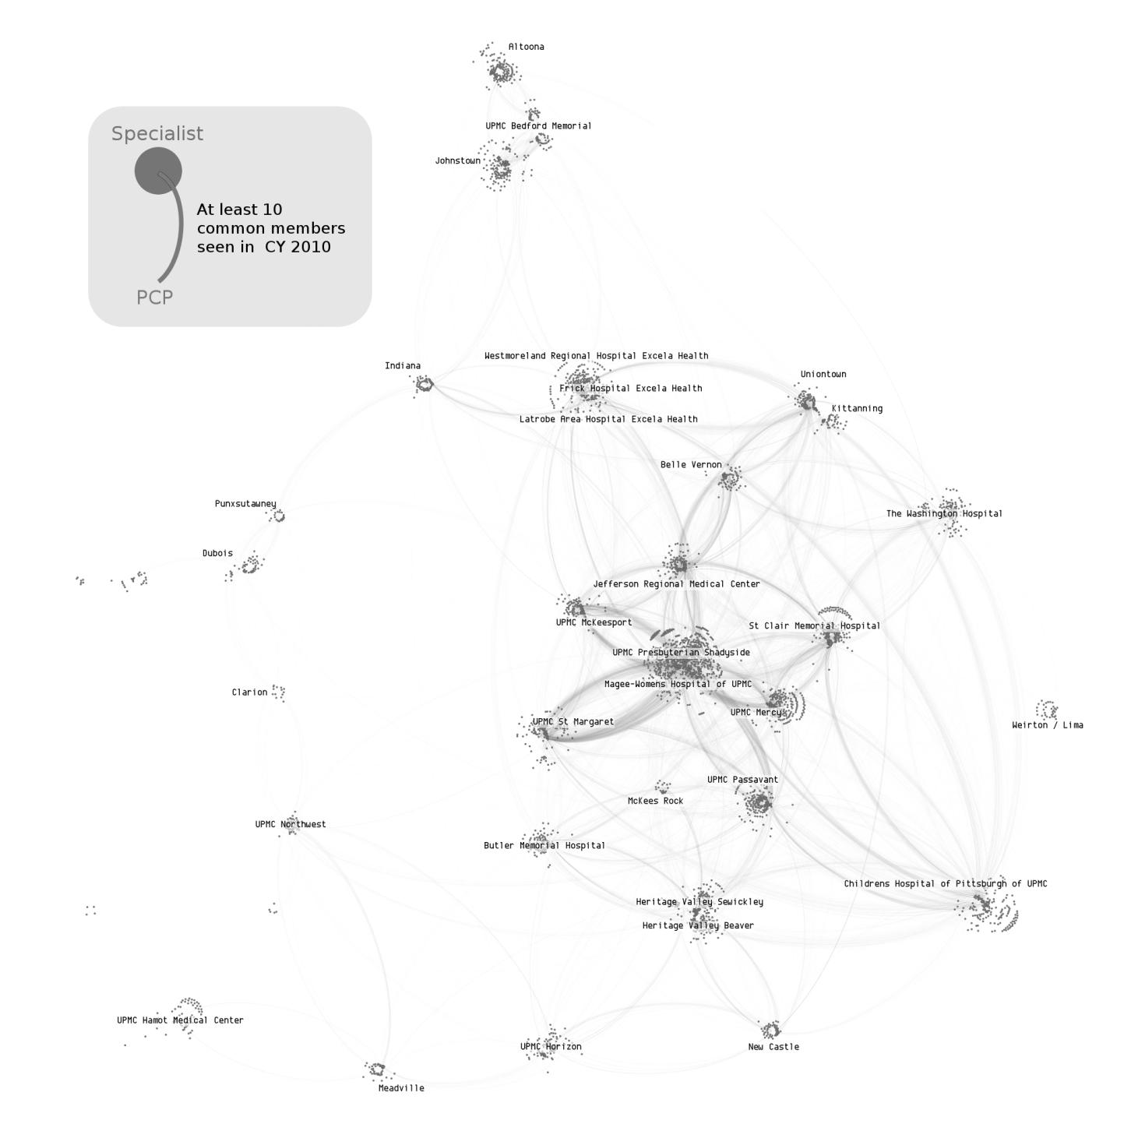
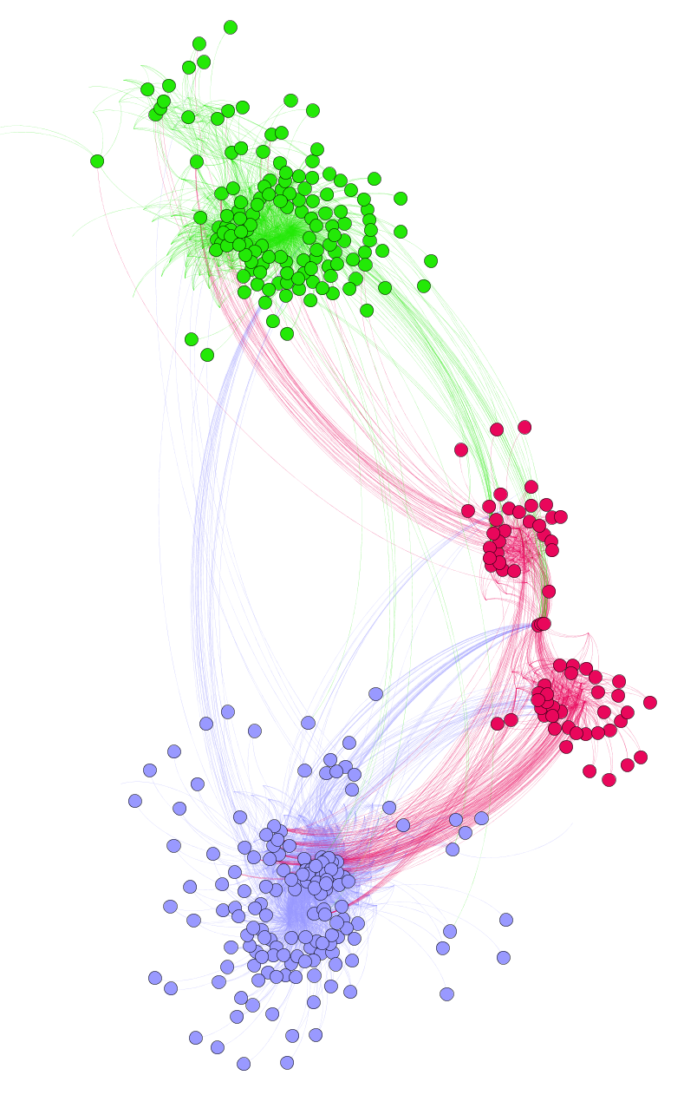
UPMC PCP – Specialist Network
Hospital A
Hospital B
Hospital C

Slide 42
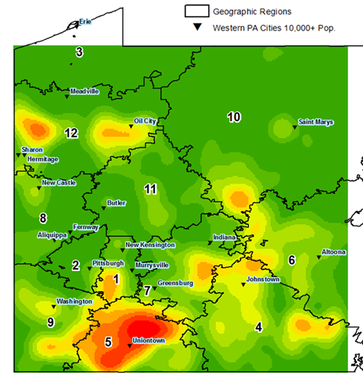
Division of Health Economics (DOHE)
Topology of Disease – Regional Population Health
Geographic Sectors
Western PA Cities 10,000+ Pop
Notes:
UPMC Payer-Provider Transformation Committee
Facilitating transformative strategy definition.
Primary Care, Specialist Care, Post-Acute Care, Supportive & Palliative Care.
Leading analytics planning, execution, and validation.
Major, complex undertaking spanning ISD and HSD.
UPMC ISD Business Strategy Retreats
Led three sessions, one for each line of business (LOB).
Identified transformative requirements to support profitable growth.
Where / how do we need to innovate ISD programs, methods, capabilities, partnerships to be successful in the new market?

Slide 43
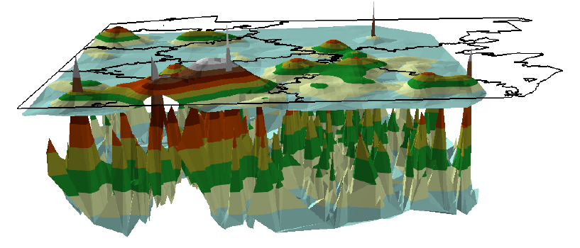
Understanding the depth of chronic illness

Slide 44
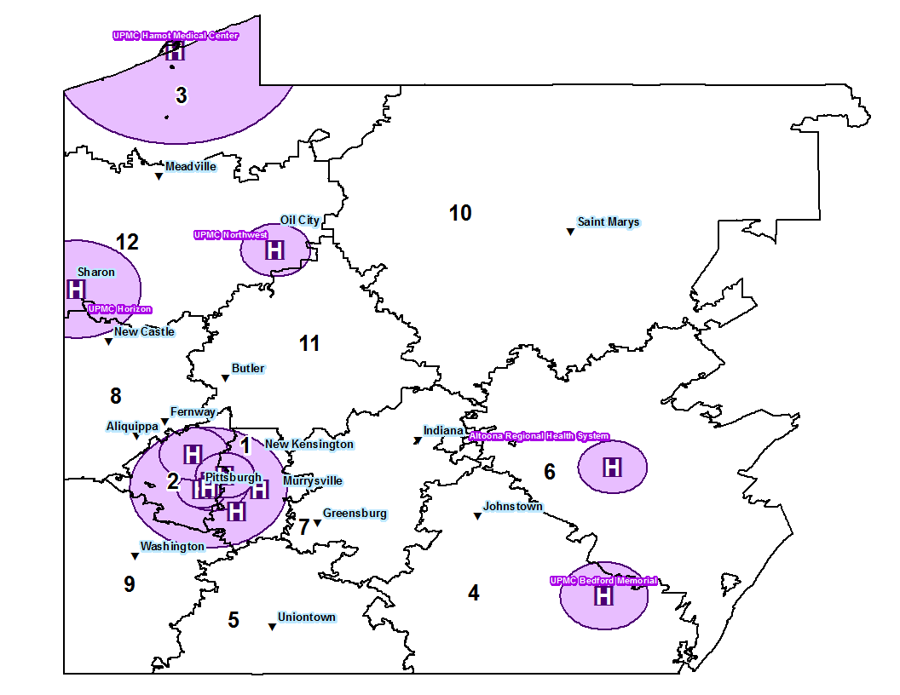

UPMC Hospitals and Catchment Areas within Geographic Regions

Slide 45
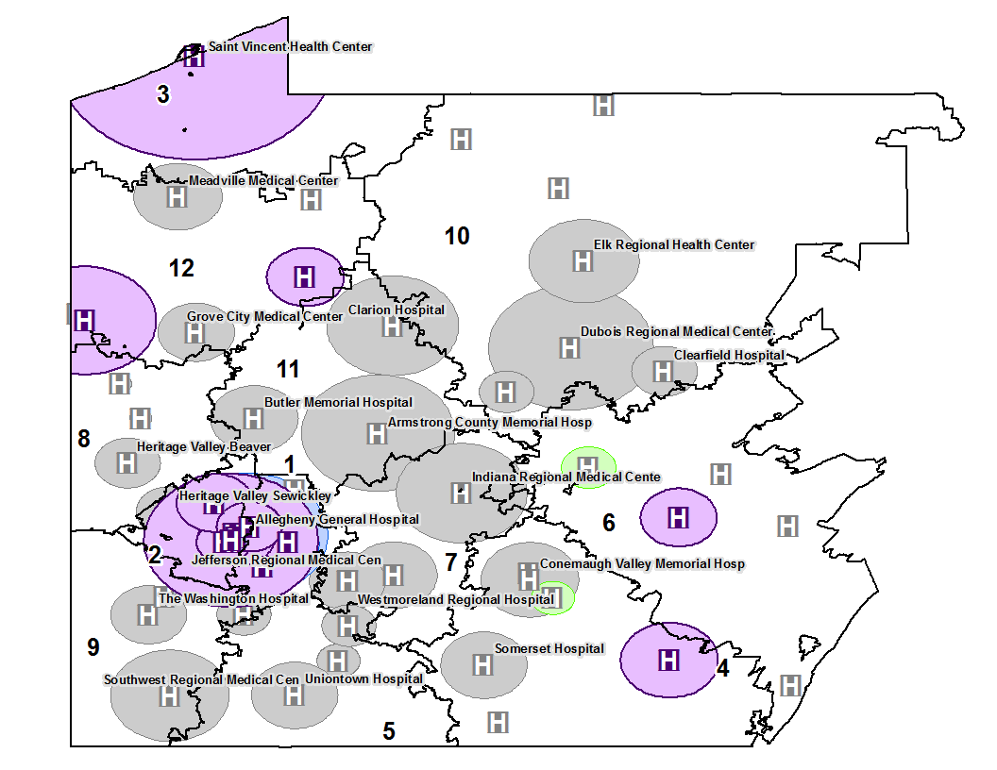
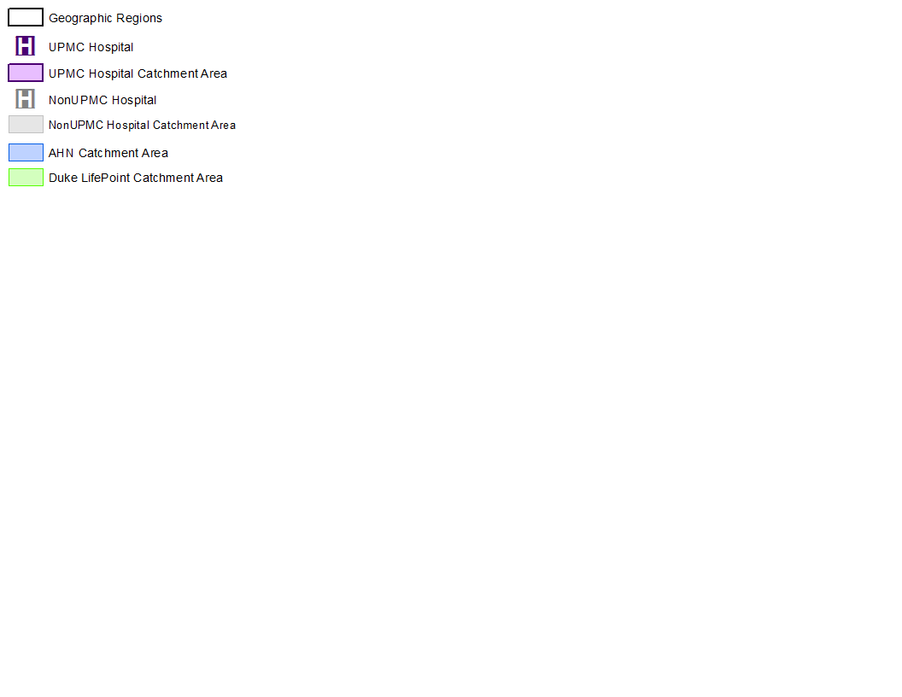
All Hospitals and Catchment Areas within Geographic Regions

Slide 46
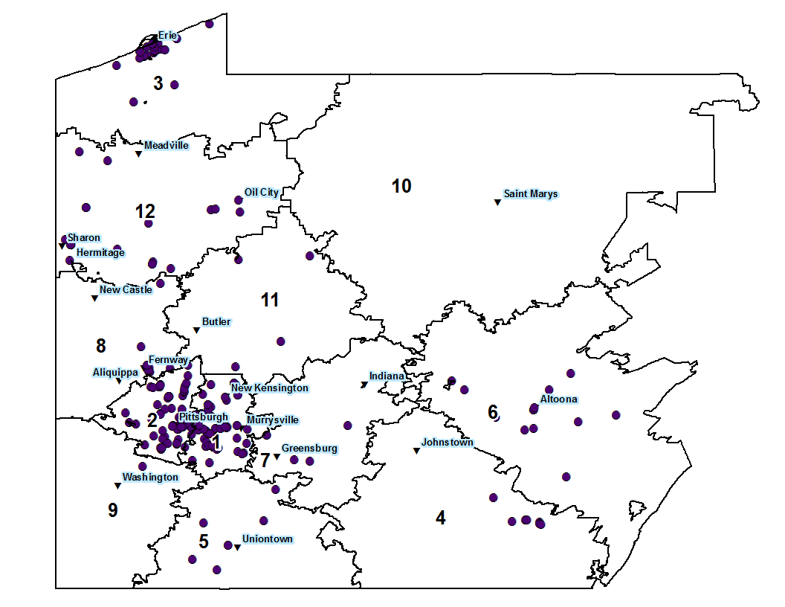

UPMC PCPs within Geographic Regions

Slide 47
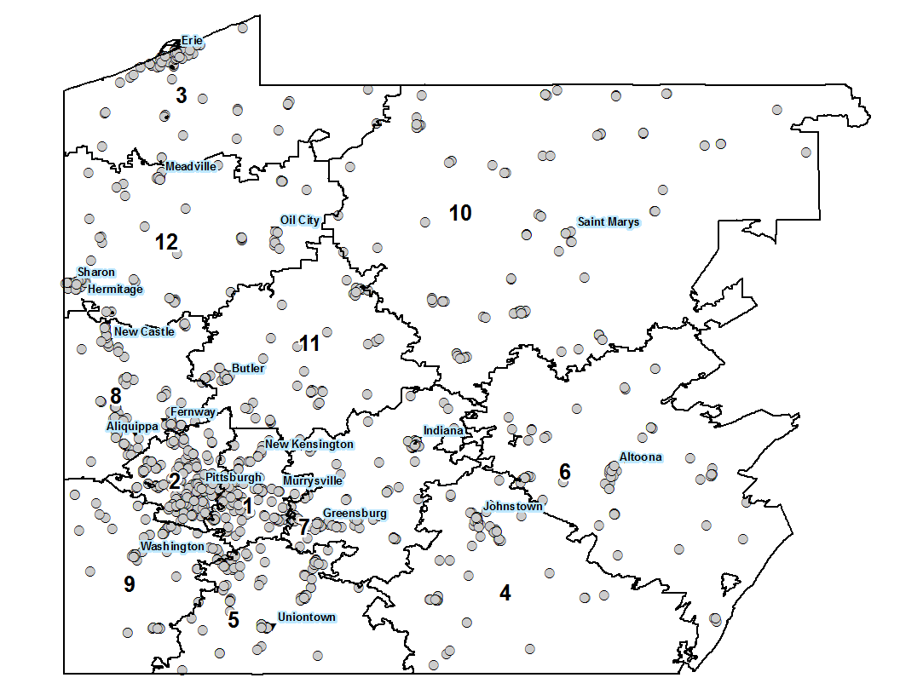

NonUPMC PCPs within Geographic Regions

Slide 48
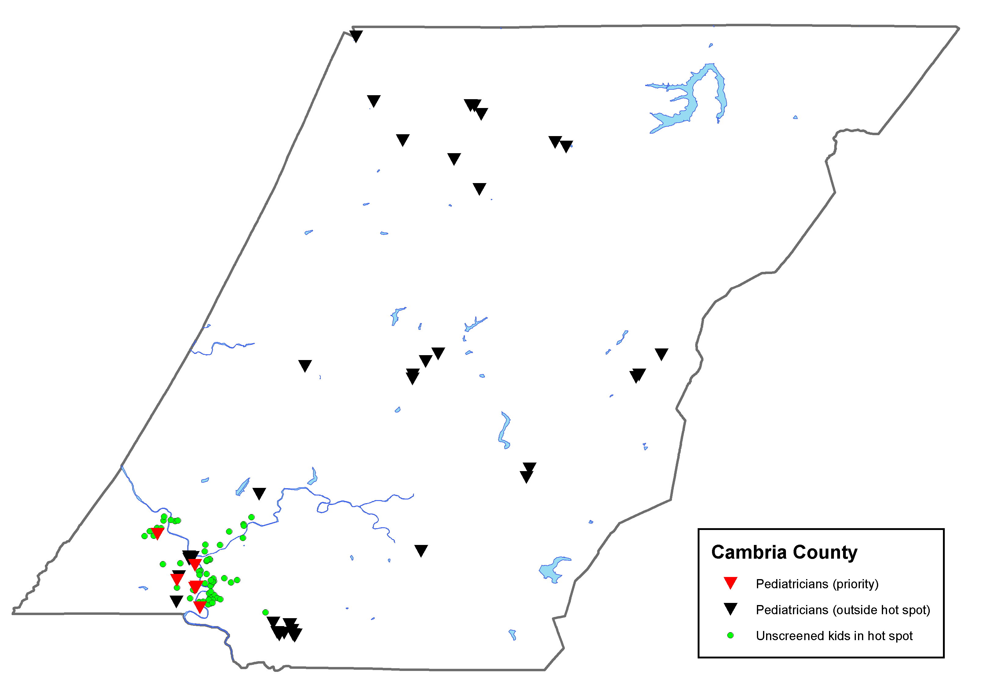
Provider sites in Lead Hot Spots: Cambria County
Johnstown

Slide 49



321 Line Drive
222 Long Lane
Medicare Advantage
Exchange
Medicare Advantage
Medicare Advantage
Commercial
Fully Insured

Slide 50
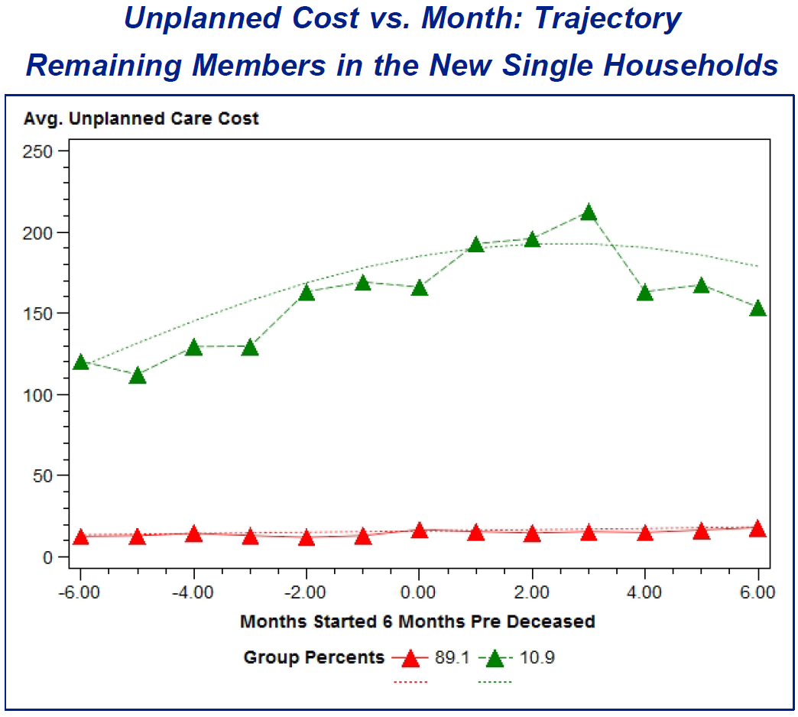
There are 3,456 members included in the trajectory analysis.
Majority of the members have $0 unplanned cost over tracked months.
Outliers above 99% percentile imputed with 99% threshold value $1325.34.

Slide 51
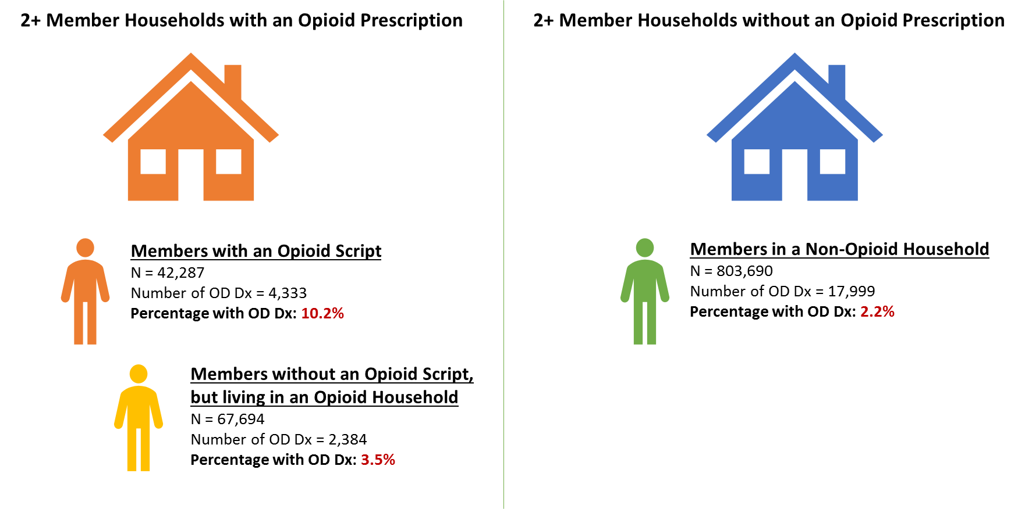
Analyzing Opioid Misuse in a 2+ Member Household
Members living in multi-member households with opioid use are significantly more likely to have an overdose diagnosis in their lifetime, regardless of who holds the prescription (p < 0.001).
Notes:
Analysis Population: members receive an overdose diagnosis from any location (PCP, ED, other)
Overdose definition:
History of any overdose during lifetime as recorded in UPMC claims data, with overdose defined as:
ICD 10 Diagnosis Code: T36 – T50 (Poisoning by, adverse effects of and underdosing of drugs, medicaments and biological substance)

Slide 52
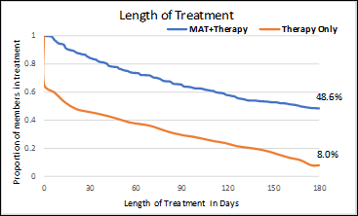
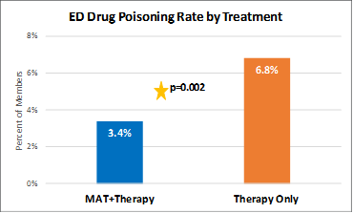
Treatment

Slide 53
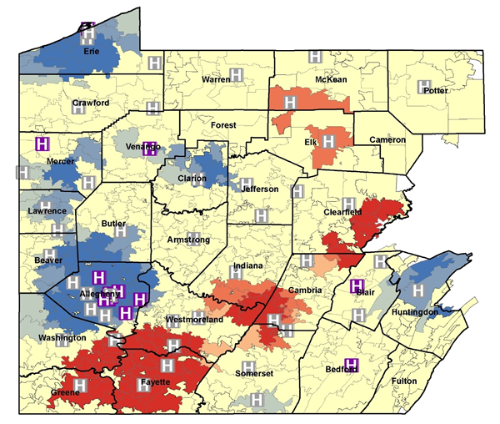
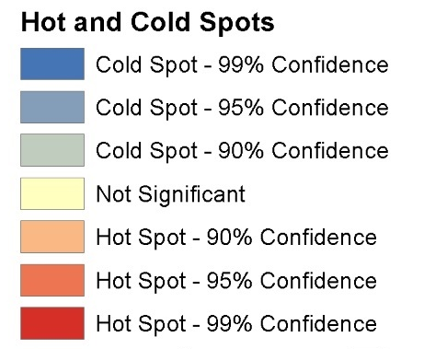
Opioid Hotspots
H
UPMC Hospital
H
Non-UPMC Hospital

Slide 54
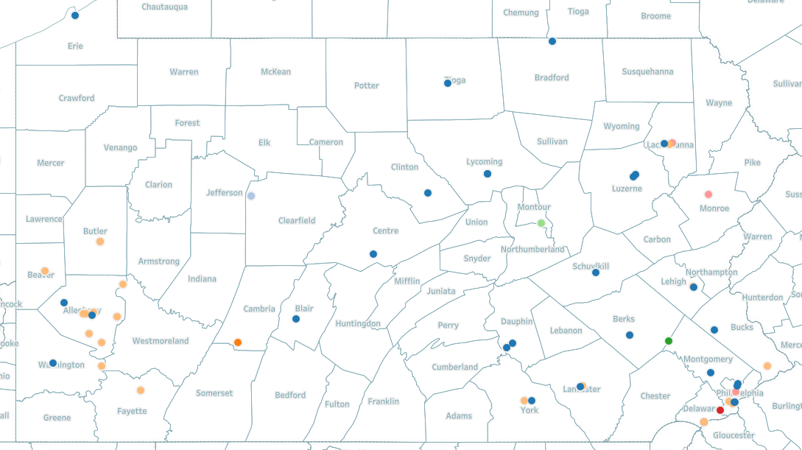
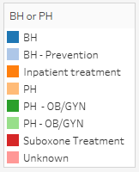
Opioid Use Disorder Centers of Excellence (COE) Locations

Slide 55




The Hard Problems in Healthcare
Notes:
67 chronic disease codes create 13 distinct “genres” of chronic disease similarities (with 3 subgenres each).

Slide 56
Disease Profile Definitions

Slide 57
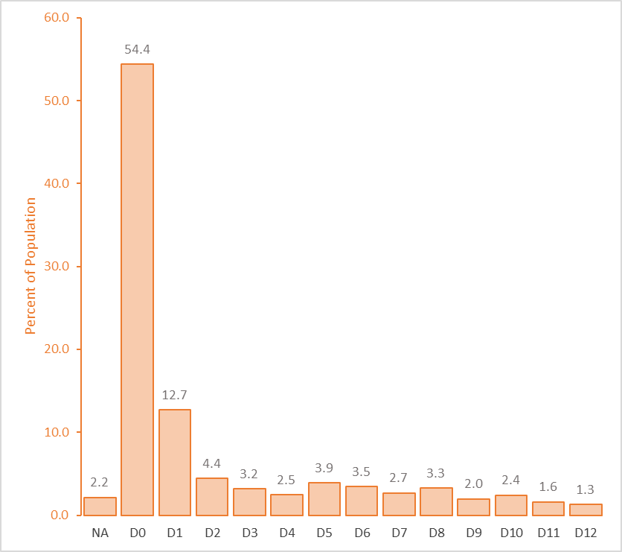
Population Break-Down by Comorbidity Profile
Over half of the population have no recorded Chronic Conditions
No History
Migraine – Primary
CAD – Primary
Anxiety – Primary
Asthma – Primary
DM - OA - Comorbid
General Conditions
Depression - Comorbid
No Recorded Conditions
Osteoarthritis (OA) - Primary
Serious Persistent Mental
Illness – Comorbid
Malignant Neoplasm - Primary
CAD - CHF - DM - Multiple- Comorbid
Diabetes (DM) - Primary

Slide 58
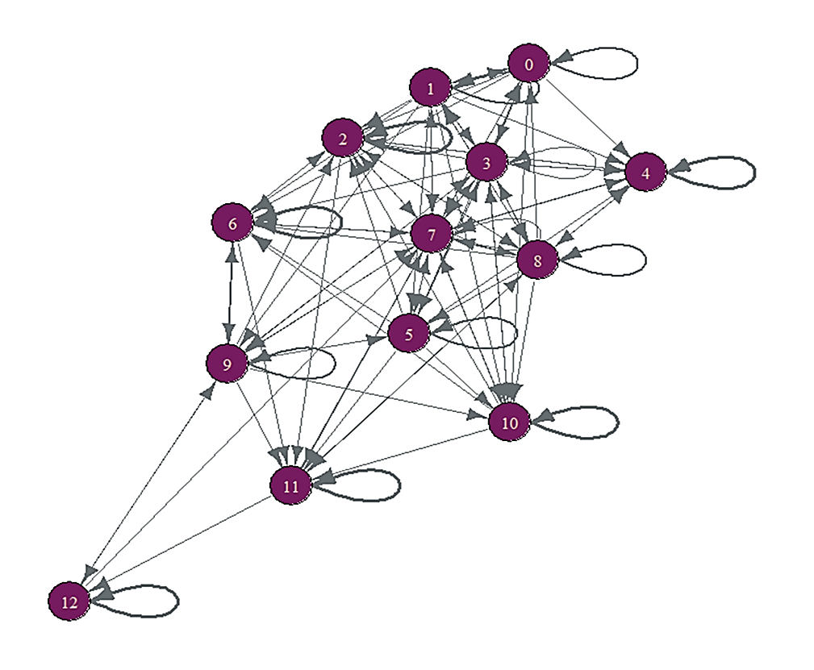
Members Can Move Among Disease Profiles

Slide 59
Why Risk Adjustment Matters
Physician A | H | M | L
Episode Mix | 40% | 50% | 10%
Average Costs | $5500 | $1500 | $700
Physician B | H | M | L
Episode Mix | 15% | 50% | 35%
Average Costs | $6400 | $1600 | $750
Raw Average Costs: $3020
Unadjusted Efficiency Ratio: 1.19
Raw Average Costs: $2023
Unadjusted Efficiency Ratio: 0.80
Standardized Average Costs: $2436
Adjusted Efficiency Ratio: 0.96
Standardized Average Costs: $2743
Adjusted Efficiency Ratio: 1.08
Population Average Episode Cost: $2535
Severity Level | H | M | L
Episode Mix | 27% | 55% | 18%
Average Costs | $5900 | $1500 | $650

Slide 60
Impact of Chronic Condition Risk Adjustment
Before:
After:

Slide 61

The Danger of Big Data

Slide 62

This is Not the Solution

Slide 63
The Dangers of Big Data
An information-rich environment creates a scarcity of what it consumes.
Herb Simon (1971)

